Slide 1

Photovoltaic Inverter Model in Simulink
EE 435 Design Project
Corey B. and Samuel T. (G-5)

Slide 2

Introduction
NREL Solar District Cup competition
Designed Solar+Storage system for New Mexico State University
For EE 435, we re-designed one of the “Grid-tie-ready” PV Inverters
Currently net metering not permitted
MOSFET H-bridge design

Slide 3

Application in Question
Corbett Center Rooftop (NMSU's “Mountainlair”)
278.2 kWDC
Canadian Solar 420W Modules
20% Bifacial Gain
SMA Sunny Tripower Core-1 String

Slide 4
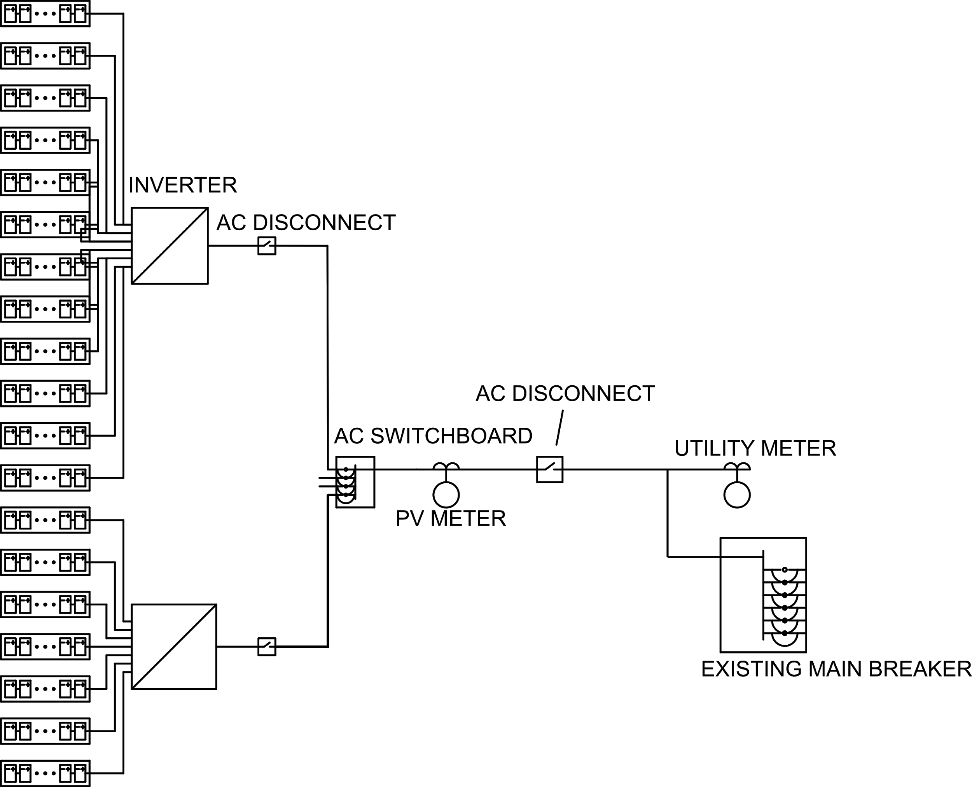
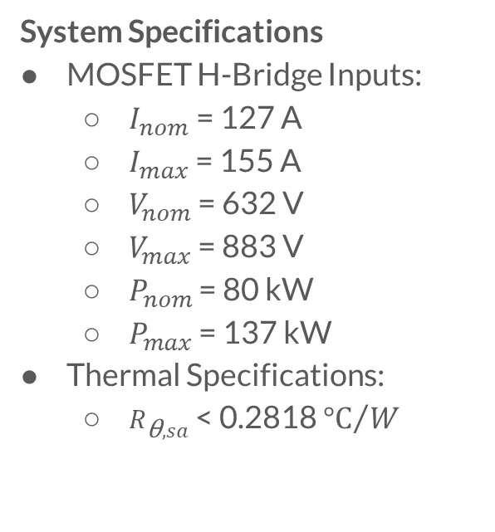
Goal: Redesign One of System’s Inverters
System Specifications
MOSFET H-Bridge Inputs:
$I_{nom}$ = 127 A
$I_{max}$ = 155 A
$V_{nom}$ = 632 V
$V_{max}$ = 883 V
$P_{nom}$ = 80 kW
$P_{max}$ = 137 kW
Thermal Specifications:
$R_{\text{θ},sa}$ < 0.2818 ${°C}/W$

Slide 5


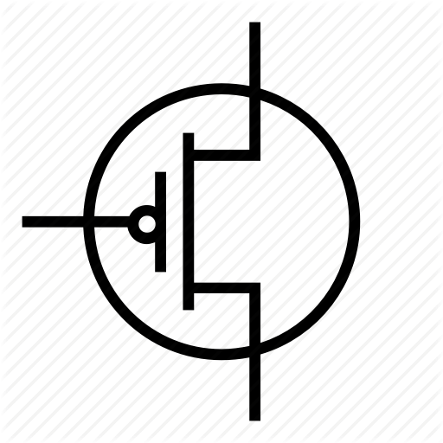

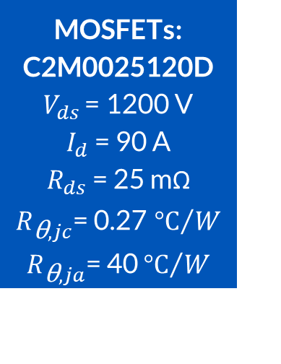

Notable Specs of Selected Devices
PV module: CS32-420PB-AG
$V_{mp}$ = 39.5 V
$I_{mp}$= 10.64 A
$V_{oc}$ = 48 V
$I_{sc}$ = 11.26 A
MOSFETs: C2M0025120D
$V_{ds}$ = 1200 V
$I_{d}$ = 90 A
$R_{ds}$ = 25 mΩ
$R_{\text{θ},jc}$= 0.27 ${°C}/W$
$R_{\text{θ},ja}$= 40 ${°C}/W$
Heatsink: Fischer Elektronik LA 6/100 12V
$R_{\text{θ},sa}$= 0.2 ${°C}/W$

Slide 6
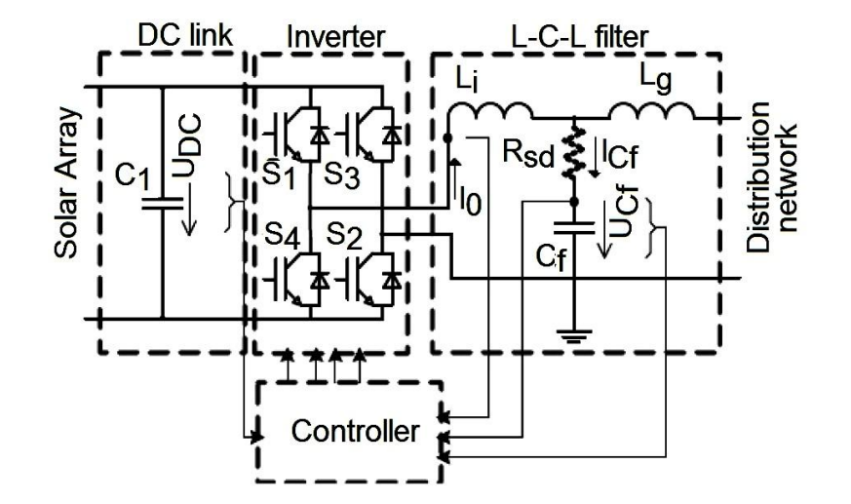
Performance Additions
DC-link capacitor
Pre-inverter filter to smooth DC signal
LC filter
Resonant filter following H-bridge
Reduces distortion in sinusoidal output
Unfortunately provides marginal attenuation of output current

Slide 7
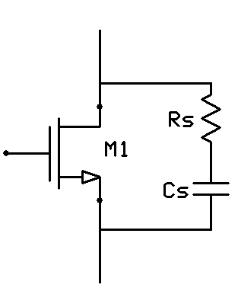
Device Protection Considerations
Heat sink
Improve lifetime of active devices
Reduce risk of destroying devices during max load
RC Snubber Circuits
Mitigates against transient events
di/dt and dv/dt protection
Anti-islanding
Useful once grid-tie permitted at NMSU
RC Snubber Circuit

Slide 8
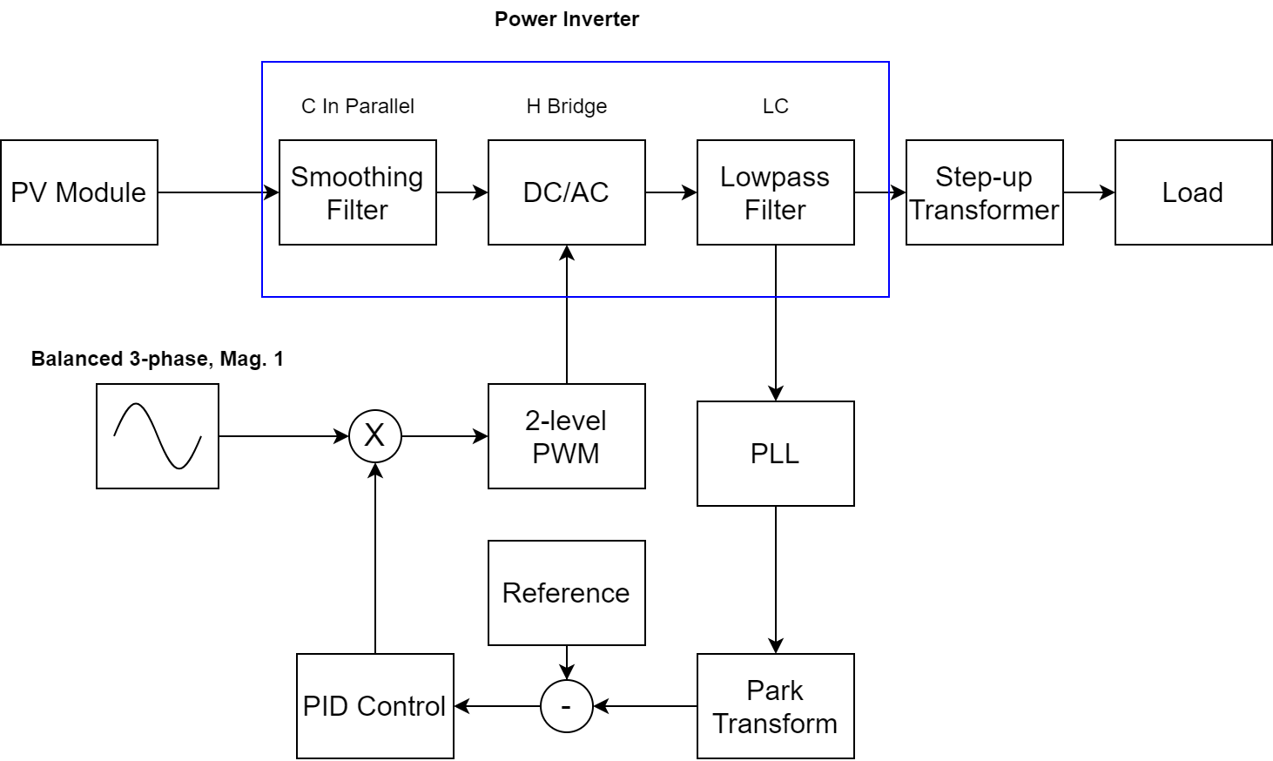
Overall Circuit Topology

Slide 9
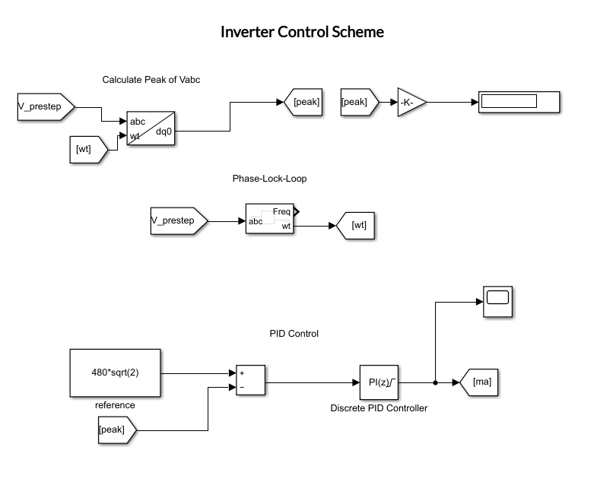
Control Scheme
Phase Lock Loop
Extract frequency from output
Park Transform (abc→dq0)
Extract peak value of output
PID controller
Multiplies PID gains by the error between desired peak and current peak calculated by Park Transform
Output (ma) is multiplied with 3-phase unit sinusoids and then input into two-level PWM generator

Slide 10
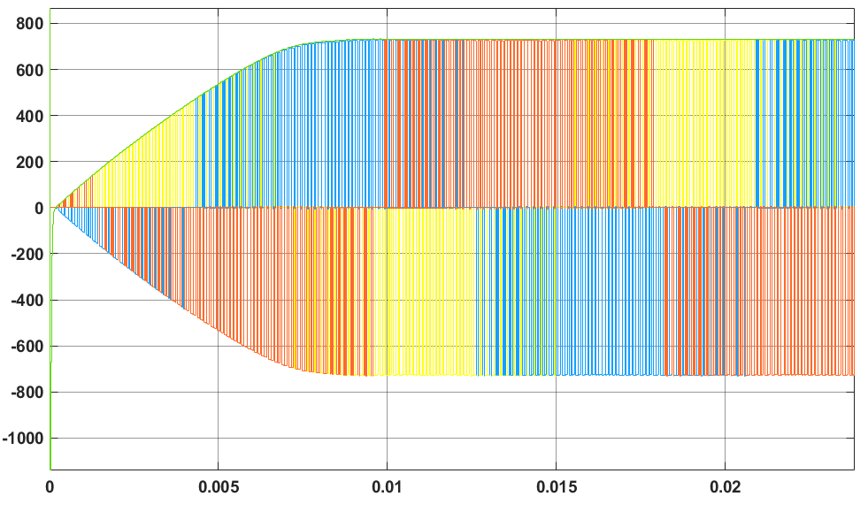
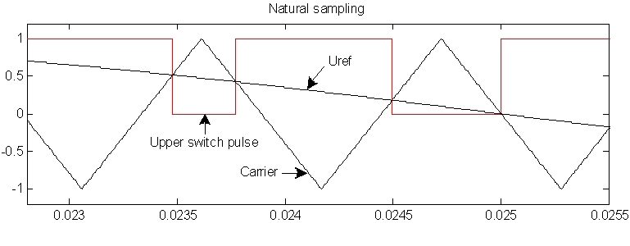
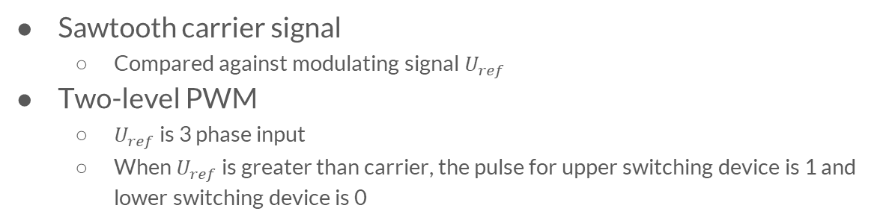
Pulse Width Modulation (PWM) Scheme
Sawtooth carrier signal
Compared against modulating signal $U_{ref}$
Two-level PWM
$U_{ref}$ is 3 phase input
When $U_{ref}$ is greater than carrier, the pulse for upper switching device is 1 and lower switching device is 0
Two Level PWM Scheme Summary
Modulated Inverter Output

Slide 11
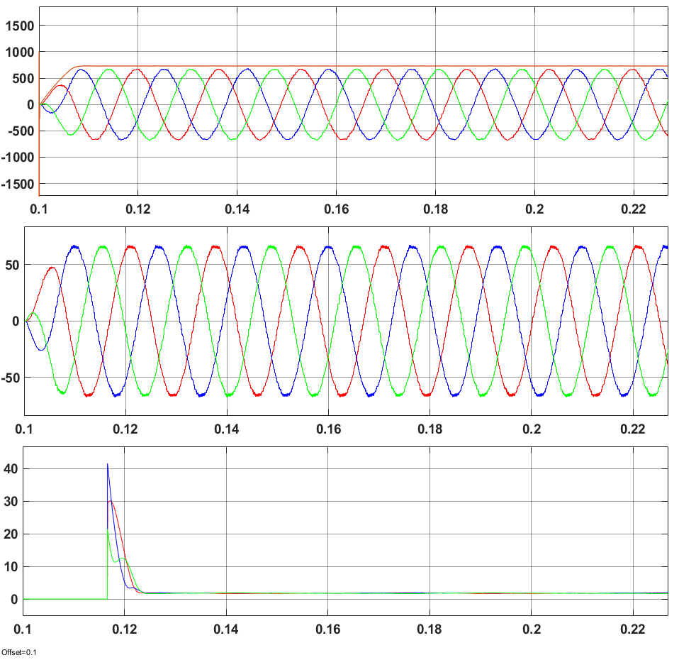
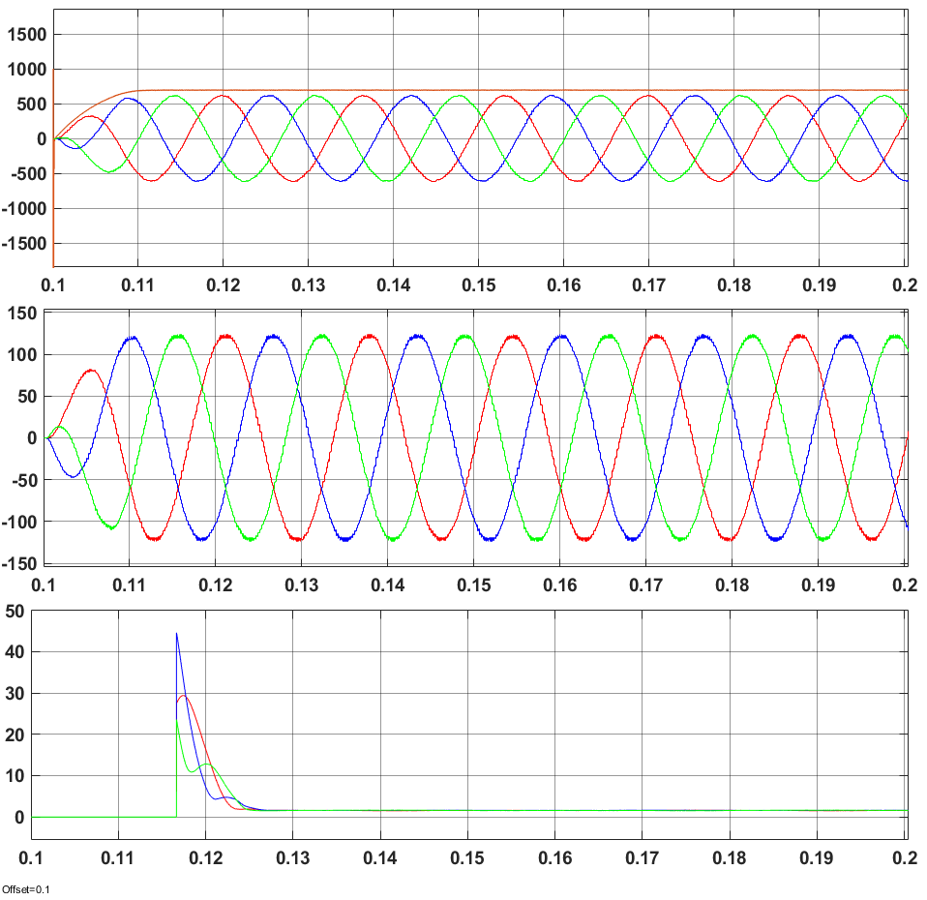
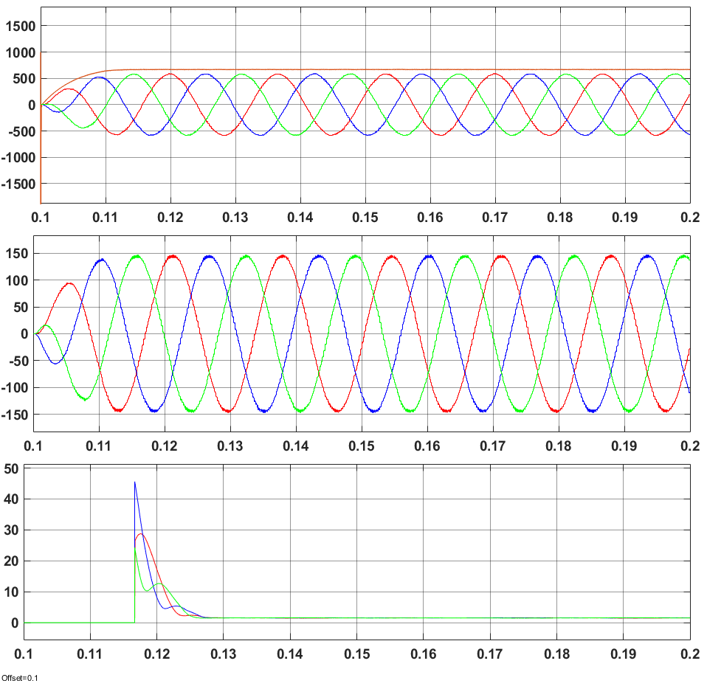
Simulation Results
Light Rated Heavy
From top to bottom, vs. time: 1. Phase-to-phase output voltages, 2. Phase currents, 3. THD

Slide 12
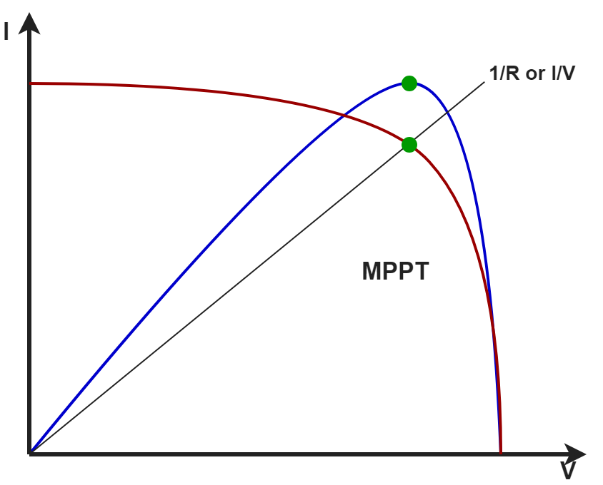
Future Work
Maximum Power Point Tracking
Maximize power utilized from source
Senses voltage and current, provides feedback to converter
Algorithmic (e.g. perturb/observe)
DC Gain Stage
Necessary for grid-tie operation
Push-pull converter considered
Improve output voltage regulation
Research superior control system
Grid-tie typically fixed-current control instead of fixed-voltage control

Slide 13
Thank you!
… any questions?

